Slide 1
Hands on OFDM crash course
(Orthogonal Frequency-division Multiplexing: standard modulation format for 5G New Radio)

Slide 2
Inspirations
"Preach the Gospel at all times; use words when necessary.“ St. Francis
“Talk is cheap. Show me the code.” Linus Torvalds
“Simplicity is the ultimate sophistication.” Steve Jobs

Slide 3
Form
„From zero to hero”: no initial requirements except arithmetisc
„Hands on” only:
no 1.5h lecture before lunch and some labs after lunch (if any)…,
writing scripts by atendee as integral and non dipensable part of the course
Example centric: miniumum of theory – learning by observations instead of facts to belive
Exaples should:
be prepared carrefully,
be focused on single aspect,
avoid „black boxes” if possible
be in form of simple:
pictures,
calculations (numerical, not symbolic),
interactive presentations,
scripts,
statements (only neccesssarty).
Above froms should interleve wherever possible
Simultanius introduction of method (DSP) and tool(box)
Toolbox (free, popular and standard)
Language: Python
IDE: Anaconda
Math. library: numpy,
Graph. library: matplotlib

Slide 4
Content
Sinewaves orthogonality
Orthogonal sinewaves amplitude modulation
DFT - iDFT
Up\down conversion

Slide 5
Content: Sinewaves orthogonality
2D vectors
Dot product formula
Orthogonal examples
Dot product vs. angle
Vector as a list of numbers
2D example
3D example
Dot product of vectors
Dot product of signals
Sum of periodical signals
Dot product of sinusoids
Sinewaves orthogonality
Orthogonal sinewaves amplitude modulation
FFT - iFFT
Up\down conversion
Vector as a signal - signal as a vector
Dot product of signals
Signal's similarity
Dot versus phase shift
Dot versus amplitudes
Interferences

Slide 6
Content: Orthogonal sinewaves amplitude modulation
Sinewaves orthogonality
Orthogonal sinewaves amplitude modulation
DFT - iDFT
Up\down conversion
TBD
TBD
Single frequency
Multiple frequencies
Single sinewave
Two sinewaves
Orthogonality
Modulation-Demodulation
Modulation-Demodulation
Modulation-Demodulation
2 frequencies
N frequencies
Mapping–Demapping
(Symbols)
Mapping–Demapping
(Constellations)
Single sinewave
per frequency
Two sinewaves
per frequency
Single sinewave
per frequency
Two sinewaves
per frequency

Slide 7
You are here
2D vectors
Dot product formula
Orthogonal examples
Dot product vs. angle
Vector as a list of numbers
2D example
3D example
Dot product of vectors
Dot product of signals
Sum of periodical signals
Dot product of sinusoids
Sinewaves orthogonality
Orthogonal sinewaves amplitude modulation
Up\down conversion
Vector as a signal - signal as a vector
Dot product of signals
Signal's similarity
Dot versus phase shift
Dot versus amplitudes
Interferences

Slide 8
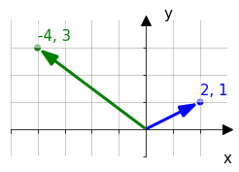
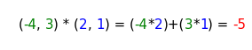
Dot product formula
Vector coordinates: b(blue) = (x, y); g(green) = (x, y)
Product formula: b*g = (x*x) + (y*y);
input: vectors,
output: scalar <- sum of multiplication of corresponding coordinates
g = (-4,3), b = (2, 1)
teacher\app_dot_2d_draw_and_calc.py

Slide 9
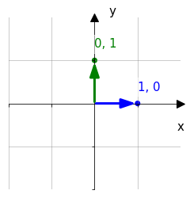
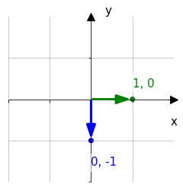
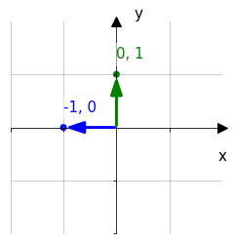
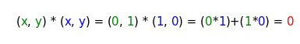
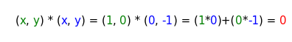
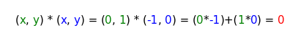
Dot Product: Orthogonal vectors examples
In all cases dot product equals to zero.
Maybe because one of the corresponding coordinates is always zero ?
0, 1
1, 0
1, 0
0,-1
0, 1
-1, 0
0, 0
0, 0
0, 0
teacher\app_dot_2d_draw_and_calc.py

Slide 10
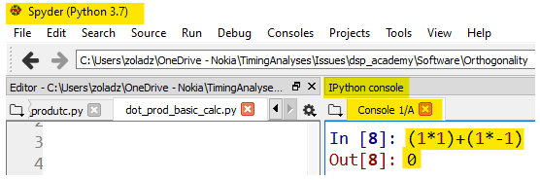
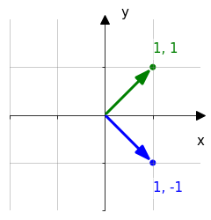
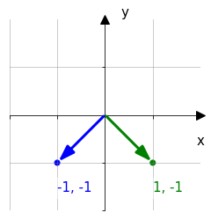
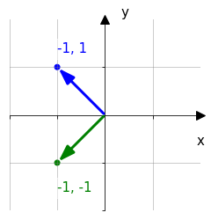
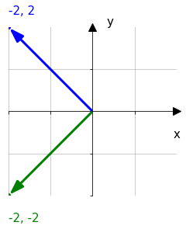
Dot Product: Orthogonal vectors examples: Nonzero coordinates
Calculate dot product of following vectors.
Use Spider REPL
REPL (stands from Read–Eval–Print Loop), A simple interactive computer programming environment
that takes single user inputs, executes them,
and returns the result to the user. [Wikipedia]
Calculations | (1*1)+(1*-1) | (-1*1)+(-1*-1) | (-1*-1)+(1*-1) | (-2*-2)+(2*-2)
result | 0 | 0 | 0 | 0
Still zero ? Maybe because we use the coordinates of the same absolute value (1 or 2)?
teacher\app_dot_2d_draw_and_calc.py

Slide 11
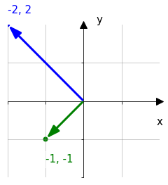
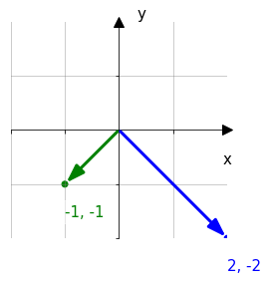
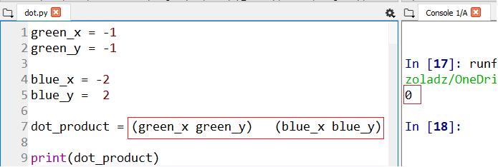
Dot Product: Orthogonal vectors examples: Nonzero coordinates, cont.
Calculate dot product of following vectors.
To work more efficiently instead of REPL use script on the right
Note: correct mistakes in dot product formula
green_x = -1
green_y = -1
blue_x = -2
blue_y = 2
dot_product = (green_x*blue_x) + (green_y*blue_y)
print(dot_product)
Fix dot product formula
Run the script (F5)
Find result in console
0 | 0
Still zero ? Maybe because we use the same absolute value of a single vector coordinates (1 or 2)?
Notes:
1_SinewavesOrthogonality\1_DotProductOfVectors\1_dot_calc_manual_crds_separate.py

Slide 12
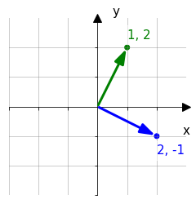
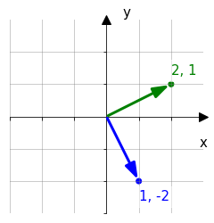
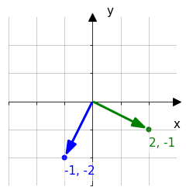
Dot Product: Orthogonal vectors examples: Nonzero coordinates, cont.
Calculate dot product of following vectors.
Use script with more concise vector coordinates notation (->).
(Use the same file)
green = [ 1, 2]
blue = [-2,-1]
dot_product = (green[0]*blue[0]) + (green[1]*blue[1])
print(dot_product)
0 | 0 | 0
Still zero ? Maybe because we use integer coordinates?
Notes:
11_SinewavesOrthogonality\1_DotProductOfVectors\2_dot_calc_crds_as_lists.py

Slide 13
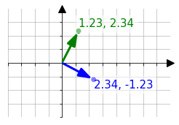
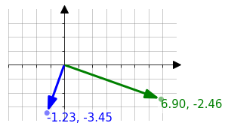
Dot Product: Orthogonal vectors examples: Nonzero coordinates, cont.
Calculate dot product of following vector configurations.
Use script version with “for” loop for iteration through vector indices. In this case these are 0 and 1.
This code works for vectors of any length.
Replace question marks with correct values.
green = [ 2,-1]
blue = [-1,-2]
dot_product = 0
for i in range(len(green)): # i = 0,..len(green)-1
dot_product += green[i] * blue[i]
print(dot_product)
0 | 0
Evidently dot product of any perpendicular vectors equals to zero. How about other angles ?
Notes:
1_SinewavesOrthogonality\1_DotProductOfVectors\3_dot_calc_loop_usage.py

Slide 14
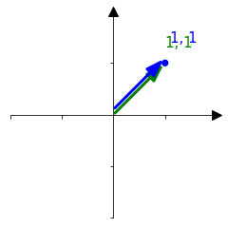
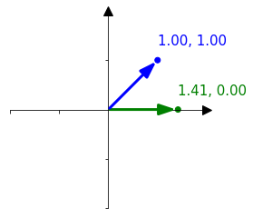
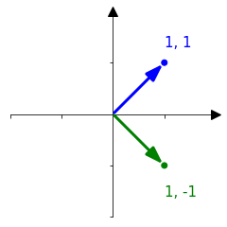
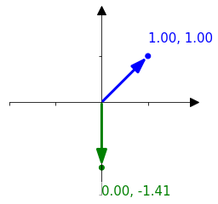
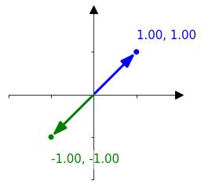
Dot Product: Non orthogonal vectors examples
Calculate dot product for the selected angles between vectors.
Take advantage of “dot” function from “numpy” library
import numpy as np # import numpy lib. and give it “np” name
green = [1,1] #(for example)
blue = [1,1]
dot_product = np.dot(green, blue) # call dot funct. from numpy
print(dot_product)
dot product | 2 | 1.41 | 0 | -1.41 | -2
For which angle dot product has maximum value and for which a minimum value?
Notes:
1_SinewavesOrthogonality\1_DotProductOfVectors\4_dot_calc_np_function.py

Slide 15
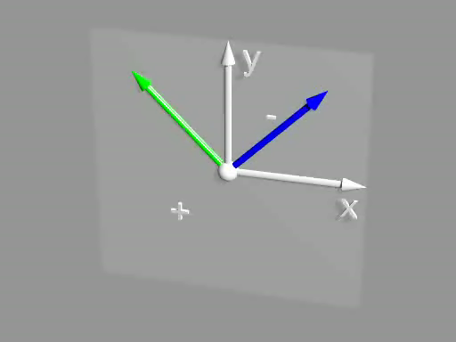
Dot Product: Non orthogonal vectors examples, cont.
Results from previous slide let us suppose that the dot product :
takes its maximum when the vectors points at same direction,
equals to zero when the vectors are orthogonal
takes its minimum when the vectors points at the opposite direction.
Click to play
2d_vect_dot.pov

Slide 16
Dot Product v.s. vectors angle
Print dot product between green and red vector for ${360}^{°}$ range with ${10}^{°}$ steps.
Assume that green vector is fixed at [0,1] and rotates blue vector.
Expected result
000: +1.000
010: +0.985
020: +0.940
...
360: +1.000
Examples
#1 generating values from 5 to 110 with step 7
for i in range(5,110,7): # yes, 110
print(i) #2 scaling above values to (0,1) range
print(i, “:", (i-5)/(110-5))
#3 using f-strings to control “numbers format”
...
print(f’{i:03d}: {(i-5)/(110-5)):+0.3f}’)
#4 rotate vector by 45 deg
from lib import rotate_vector
vector = [0,1]
rot_vector= rotate_vector(vector,45)
print(rot_vector)
Notes:
1_SinewavesOrthogonality\1_DotProductOfVectors\5_dot_calc_angle_range_print.py

Slide 17
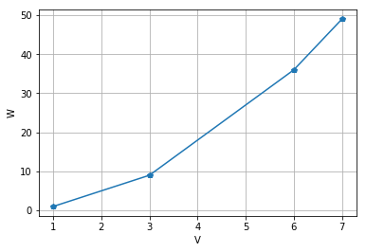
Dot Product v.s. vectors angle, cont.
“Replace” printing with plotting
dot
angle
6_plot_example.py
7_list_example_student.py
8_dot_calc_angle_range_plot_student.py
#1 drawing plot with matplotlib
import matplotlib.pyplot as plt
v = [1,3, 6, 7]
w = [1,9,36,49]
plt.plot(v, w, '-p')
plt.xlabel('V')
plt.ylabel('W')
plt.grid()
#2 generate “w” list from “v” list
v = [1,3,6,7]
w = list()
for i in v:
w.append(i*i)
print(w)
#3 complete task
v = [0, 1]
angle_list = []
dot_list = []
for angle in range(0,370,10):
angle_list.append(angle)
v_rot = rotate_vector(v, angle)
dot = np.dot(v, v_rot) dot_list.append(dot)
plt.plot(angle_list,dot_list)
plt.xlabel(“Angle”)
plt.ylabel(“Dot”)
plt.grid()
Notes:
1_SinewavesOrthogonality\1_DotProductOfVectors\:
- 6_plot_example.py
- 7_list_example.py
- 8_dot_calc_angle_range_plot.py

Slide 18
You are here
2D vectors
Dot product formula
Orthogonal examples
Dot product vs. angle
Vector as a list of numbers
2D example
3D example
Dot product of vectors
Dot product of signals
Sum of periodical signals
Dot product of sinusoids
Sinewaves orthogonality
Orthogonal sinewaves amplitude modulation
Up\down conversion
Vector as a signal - signal as a vector
Dot product of signals
Signal's similarity
Dot versus phase shift
Dot versus amplitudes
Interferences

Slide 19
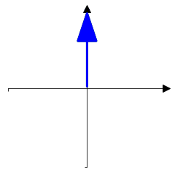
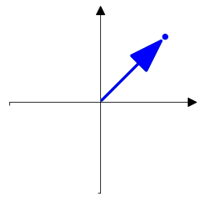
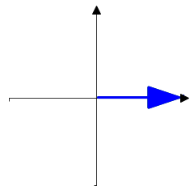
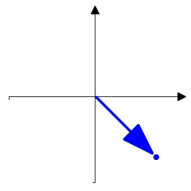
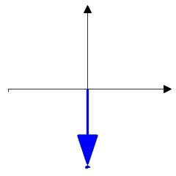
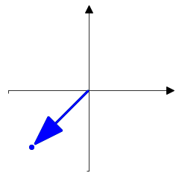
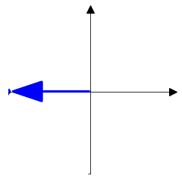
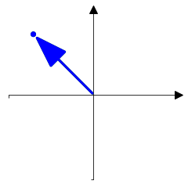
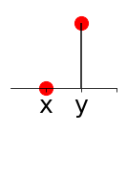
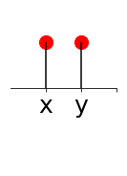
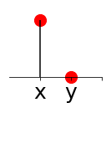
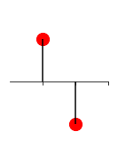
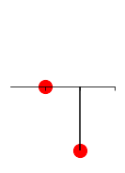
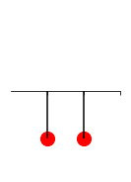
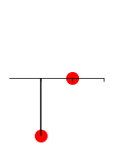
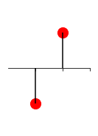
Vector as a list of numbers: 2D example
2D vector can be presented on a single axis as a list of values (coordinates)
1
y
x
1
teacher\vector_saples_view_2d.py
1
0.707
0
- 0.707
- 1

Slide 20
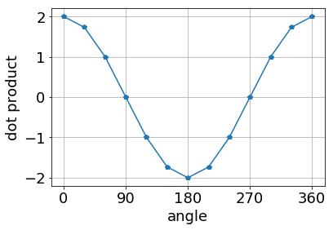
Vector as a list of numbers: 2D example, cont.
Use dot product and Python (REPL o script) to find orthogonal and antiparallel vectors for given vectors
1
2
3
4
5
6
7
8
0.707, -0.707
1, 0
0, 1
0.707, 0.707
0, -1
-0.707, -0.707
-0.707, 0.707
-1, 0
Write down indexes of vectors which are:
cheat sheet
Given vectors index | Orthogonal | Orthogonal | Antiparallel
4 | 1 | 7 | 6
8 | 3 | 5 | 2
teacher\aux_dot_calc_angle_range_plot.py

Slide 21
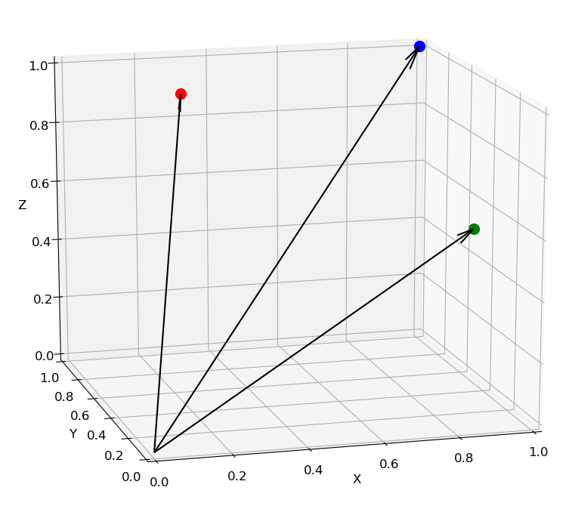
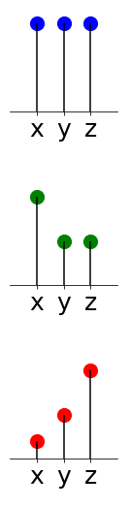
Vector as a list of numbers: 3D example
Also, 3D vector can be presented on a single axis.
1.0
0.5
0.2
Teacher\vector_3d_cartesian_viev.py

Slide 22
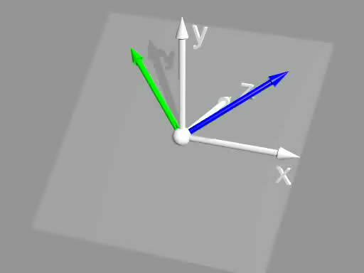
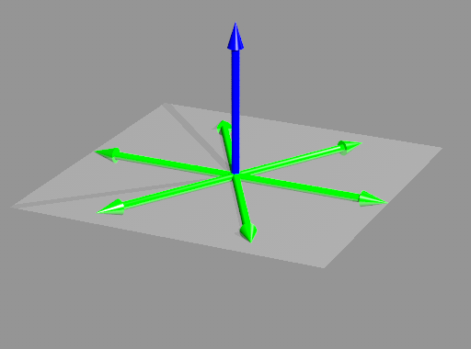
Vector as a list of numbers: 3D example, cont.
As in case od 2D vectors a dot product allows to check
how two 3D vectors are oriented towards each other
(parallel, antiparallel, orthogonal and so on)
Unlike the 2D vector, the specified 3D vector can have
an infinite number of orthogonal vectors
Click to see how does dot product “work” for 2D vectors
3d_vect_dot.pov
3d_vect_dot_infit othog.pov

Slide 23
You are here
2D vectors
Dot product formula
Orthogonal examples
Dot product vs. angle
Vector as a list of numbers
2D example
3D example
Dot product of vectors
Dot product of signals
Sum of periodical signals
Dot product of sinusoids
Sinewaves orthogonality
Orthogonal sinewaves amplitude modulation
Up\down conversion
Vector as a signal - signal as a vector
Dot product of signals
Signal’s similarity
Dot versus phase shift
Dot versus amplitudes
Interferences

Slide 24
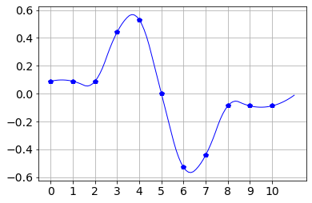
Vector as a signal - signal as a vector
In fact, any list of values (scalars) can be considered a vector in a space. The dimension of space equals to values number.
Examples:
2D: (2.3, 0.4): x=2.3, y=0.4
3D: (2.3, 0.4, 12.7): x=2.3, y=0.4, z= 12.7
4D: (2.3, 0.4, 12.7, 9.2): x=2.3, y=0.4, z= 12.7, ź=9.2
ND: (2.3, 0.4, 12.7, 9.2, … , 17.3): x=2.3, y=0.4, z= 12.7, ź=9.2, … Ώ=17.3
0 , 1 , 2 , 3 , … , N <- coordinate indexes
On the other hand, any signal is a list of values, so any signal can be considered a vector in N dimensional space.
Axes
X
Y
Z
Ώ

Slide 25



Dot Product of signals
As it was said dot product let us measure how two vectors are oriented towards each other, so, dot product let us also measure relation between two signals (parallel, antiparallel, orthogonal, and so one).
A
One can say that dot product let us evaluate a degree of similarity between two signals.
B
A * B
t[s]
$$\sum_{i=0}^{10}{A[i]∗B[i]=0.4924}$$
Teacher\vector-signal_dot_plot.py
dot product ->

Slide 26




Signals similarity evaluation by using do product
Use Python (REPL or script) to replace question marks with dot product. Use signal samples value given on the top of the plots
Use round(x,6) when printing dot value
0.088 0.088 0.088 0.442 0.530 0.000 -0.530 -0.442 -0.088 -0.088 -0.088
0.080 0.080 0.080 0.398 0.477 0.000 -0.477 -0.398 -0.080 -0.080 -0.080
0.129 0.129 0.129 0.514 0.643 0.000 0.129 0.129 0.129 0.129 0.129
-0.129 -0.129 -0.129 -0.514 -0.643 -0.000 -0.129 -0.129 -0.129 -0.129 -0.129
-0.080 -0.080 -0.080 -0.398 -0.477 -0.000 0.477 0.398 0.080 0.080 0.080
B
A
0.899692
0.44259
-0.44259
-0.899692
A
*
B

Slide 27




Signals similarity evaluation by using do product, cont.
Please continue
0.088 0.088 0.088 0.442 0.530 0.000 -0.530 -0.442 -0.088 -0.088 -0.088
0.000 0.050 0.000 -0.050 0.000 0.050 0.000 -0.050 0.000 0.050 0.000
0.500 0.550 0.500 0.450 0.500 0.550 0.500 0.450 0.500 0.550 0.500
0.500 0.650 0.500 0.350 0.500 0.650 0.500 0.350 0.500 0.650 0.500
-0.500 -0.350 -0.500 -0.650 -0.500 -0.350 -0.500 -0.650 -0.500 -0.350 -0.500
0
0
0
0

Slide 28
Signals similarity evaluation by using do product, cont.
Find analogy between signal pairs and 2D vectors pairs
Put vectors figures below proper signal figures

Slide 29
Plots customization: Example
Example of generation of vectors (1D array) with sinusoid and triangle waves
data preparation
import numpy as np
import matplotlib.pyplot as plt
from scipy import signal #required for triangle signal generation
# DATA CREATION
# definition of pi constant by using numpy library
pi = np.pi
# time vector.
# from zero to 2pi in 30 steps
t = np.linspace(0, 3*2*pi,60, endpoint=False) #
# “simple” sinusoid
sin_a = np.sin(t)
# sinusoid with amplitude equal to 2 and time shift qual to pi/4
sin_b = 2*np.sin(t+pi/4)
# triangular waveforms
#"0.5" denotes proportion between positive and negative slope
trian_a = signal.sawtooth(t,0.5)
trian_b = 2*signal.sawtooth(t+pi/2, 0.5)
trian_c = trian_a+trian_b
Notes:
1_SinewavesOrthogonality\2_PlotsCustomization\example.py

Slide 30

Plots customization: Example cont.
Simple plotting
# adding waveforms to figure
plt.plot(t,sin_a)
plt.plot(t,sin_b)
# drawing figure
plt.show()
Plots customization
# adding waveforms to figure
plt.plot(t,trian_a, 'p', label='ampl=1, phase=0', color='blue')
plt.plot(t,trian_b,'-p', label='ampl=2, phase=pi/2', color='green')
plt.plot(t,trian_c,'--', label='sum', color='brown')
# customizing figure
plt.title('Trianle waveform')
plt.xlabel('time[s]')
plt.ylabel('amplitude[a.u.]')
plt.xlim(10,20)
plt.ylim(-2,4)
plt.axhline(y=0,color='red')
plt.grid()
plt.legend()
# drawing figure
plt.show()

Slide 31

Plots customization: Exercise
Generate figure as below. Don’t forget about figure and axes titles, legend content and axes ranges
Notes:
1_SinewavesOrthogonality\2_PlotsCustomization\exercise.py

Slide 32
You are here
2D vectors
Dot product formula
Orthogonal examples
Dot product vs. angle
Vector as a list of numbers
2D example
3D example
Dot product of vectors
Dot product of signals
Sum of periodical signals
Dot product of sinusoids
Sinewaves orthogonality
Orthogonal sinewaves amplitude modulation
Up\down conversion
Vector as a signal - signal as a vector
Dot product of signals
Signal’s similarity
Dot versus phase shift
Dot versus amplitudes
Interferences

Slide 33

Sum of periodic signals (same frequency)
Run script for 2 types of signals (read comments carefully)
…
from scipy import signal
…
t = np.linspace(0, 3*(2*pi),100, endpoint=False)
y_sum = np.zeros(len(t)) # sumaric vector filled with zeros
for i in range(3): # nr of components
# generating random values of phase shift and amplitude
# “rand” function generates single random nr in range from 0 to 1
phase = np.random.rand()*(2*pi)
ampl = np.random.rand()
# generating different waveforms
# select single waveform by commenting the remaining ones
y = ampl * np.sign(np.sin(t+phase)) # rectangle
#y = ampl * signal.sawtooth(t+phase,0.5) # triangle
plt.plot(t,y,'-')
y_sum = y_sum + y
plt.title('Componenets')
plt.show()
plt.title('Sum')
plt.plot(t,y_sum,'-')
plt.show()
Notes:
c:\Users\zoladz\OneDrive - Nokia\dsp_academy\Chapters_v4\1_SinewavesOrthogonality\3_SumOfPeriodicalSignals\exercise.py

Slide 34


Sum of periodic signals (same frequency), cont.
Extend the script with sinus wave generation
Place below extended script and plots
Script
Plots
import numpy as np
import matplotlib.pyplot as plt
from scipy import signal
pi = np.pi
t = np.linspace(0, 3*(2*pi),100, endpoint=False)
y_sum = np.zeros(len(t)) # summaric vector filled with zeros
for i in range(3): # "3' - nr of componenets
# generating random values of phase shift and amplitudes
# rand function generates single random nr in range from 0 to 1
phase = np.random.rand()*(2*pi)
ampl = np.random.rand()
# generating different waveforms
# select single waveform by comenting the remaining ones
# = ampl * signal.sawtooth(t+phase,0.5) #triangle
#y = ampl * np.sign(np.sin(t+phase)) # rectangle
y = ampl * np.sin(t + phase) #sinus
plt.plot(t,y,'-')
y_sum = y_sum + y
plt.title('Componenets')
plt.show()
plt.title('Sum')
plt.plot(t,y_sum,'-')
plt.show()

Slide 35
Sum of periodic signals (same frequency): conclusion
Which waveform type is exceptional and why ?
Sinusoid is exceptional because sum of sinusoids is also a sinusoid.

Slide 36
You are here
2D vectors
Dot product formula
Orthogonal examples
Dot product vs. angle
Vector as a list of numbers
2D example
3D example
Dot product of vectors
Dot product of signals
Sum of periodical signals
Dot product of sinusoids
Sinewaves orthogonality
Orthogonal sinewaves amplitude modulation
Up\down conversion
Vector as a signal - signal as a vector
Dot product of signals
Signal’s similarity
Dot versus phase shift
Dot versus amplitudes
Interferences

Slide 37


dot vs. phase shift
Fix and complete following script to generate plots and prints as shown on the right
On the next page put plots for given phase shifts ->
Notes:
1_SinewavesOrthogonality\4_DotProductOfSinusoids\1_DotVsPahseShift.py

Slide 38
















0
pi/8
pi/4
pi/3
pi/2
dot product = 10.61
dot product = 7.50
dot product = 0.0
np.pi/2 + np.pi/8
np.pi/2 + np.pi/4
np.pi/2 + np.pi/3
np.pi/2 + np.pi/2
dot product = -5.74
dot product = -10.61
dot product = -12.99
dot product = -15

Slide 39

dot vs. phase shift, cont.
Base on results from previous page plot relationship between dot product value and phase ship value
Write script to do that
Place figure with plot here
Notes:
1_SinewavesOrthogonality\4_DotProductOfSinusoids\1_DotVsPahseShift_Summary.py

Slide 40


dot vs. phase shift, cont.
Base on results from previous page
assign plots to points on “phase shift – dot value” plot

Slide 41




dot vs. phase shift, cont
Put vector figures below proper sinusoids plots

Slide 42
You are here
2D vectors
Dot product formula
Orthogonal examples
Dot product vs. angle
Vector as a list of numbers
2D example
3D example
Dot product of vectors
Dot product of signals
Sum of periodical signals
Dot product of sinusoid
Sinewaves orthogonality
Orthogonal sinewaves amplitude modulation
Up\down conversion
Vector as a signal - signal as a vector
Dot product of signals
Signal’s similarity
Dot versus phase shift
Dot versus amplitudes
Interferences

Slide 43

dot versus amplitudes
Examine dot product of two sinewaves of the same frequency and phase for time vectors of different size. Use following script to fill below table
TIME_VECTOR_SIZE=15
AMP_B \ AMP_A | 0 | 1 | 2
0 | 0 | 0 | 0
1 | 0 | 7.5 | 15
2 | 0 | 15 | 30
TIME_VECTOR_SIZE=30
AMP_B \ AMP_A | 0 | 1 | 2
0 | 0 | 0 | 0
1 | 0 | 15 | 30
2 | 0 | 30 | 60
Base on table content write formula illustrating relationship between
dot product value and values of T_VECTOR_SIZE, AMP_A and AMP_B
dot_product(T_VECTOR_SIZE, AMP_A, AMP_B) =
= AMP_A * AMP_B * VECTOR_SIZE / 2
Notes:
1_SinewavesOrthogonality\4_DotProductOfSinusoids\2_DotVsAmplitudes.py

Slide 44

dot versus amplitudes : normalization
Set amplitude of sine “A” (reference signal) at value 1.
Extend previous script with measurement of sine “B“ amplitude base on dot product.
The measured value should not depend on TIME_VECTOR_SIZE (normalization).
Expected result
TIME_VECTOR_SIZE=15
AMP_B \ AMP_A | 1
0 | 0
1 | 1
2 | 2
TIME_VECTOR_SIZE=30
AMP_B \ AMP_A | 1
0 | 0
1 | 1
2 | 2
We will call above process normalization
Notes:
1_SinewavesOrthogonality\4_DotProductOfSinusoids\2_DotVsAmplitudes_Normalization.py

Slide 45
You are here
2D vectors
Dot product formula
Orthogonal examples
Dot product vs. angle
Vector as a list of numbers
2D example
3D example
Dot product of vectors
Dot product of signals
Sum of periodical signals
Dot product of sinusoids
Sinewaves orthogonality
Orthogonal sinewaves amplitude modulation
Up\down conversion
Vector as a signal - signal as a vector
Dot product of signals
Signal’s similarity
Dot versus phase shift
Dot versus amplitudes
Interferences

Slide 46

Dot product of the same frequency sinewaves: Interferences
Let's assume we have signal which is the sum of two sinusoids. Will it be possible to measure amplitude of each sinusoid in it or maybe they will interfere?

Slide 47


Dot product of the same frequency sinewaves: interferences, cont.
Complete script to implement given scheme.
Use the script to fill table
INTERFER SHIFT = pi/4
INTERFER_AMP=1 |  |  | CARRIER_TX_AMP=1
CARRIER_TX AMP | CarrierRx Ampl |  | INTERFER_AMP | CarrierRx Ampl
0.00 | 0.7 |  | 0.00 | 1
0.50 | 1.2 |  | 0.50 | 1.4
1.00 | 1.7 |  | 1.00 | 1.7
1.50 | 2.2 |  | 1.50 | 2.1
2.00 | 2.7 |  | 2.00 | 2.4
INTERFER SHIFT = pi/2
INTERFER_AMP=1 |  |  | CARRIER_TX_AMP=1
CARRIER_TX AMP | CarrierRx Ampl |  | INTERFER_AMP | CarrierRx Ampl
0.00 | 0 |  | 0.00 | 1
0.50 | 0.5 |  | 0.50 | 1
1.00 | 1.0 |  | 1.00 | 1
1.50 | 1.5 |  | 1.50 | 1
2.00 | 2 |  | 2.00 | 1
INTERFER SHIFT = pi/2+pi/8
INTERFER_AMP=1 |  |  | CARRIER_TX_AMP=1
CARRIER_TXAMP | CarrierRx Ampl |  | INTERFER_AMP | CarrierRx Ampl
0.00 | -0.4 |  | 0.00 | 1
0.50 | 0.1 |  | 0.50 | 0.8
1.00 | 0.6 |  | 1.00 | 0.6
1.50 | 1.1 |  | 1.50 | 0.4
2.00 | 1.6 |  | 2.00 | 0.2
Notes:
1_SinewavesOrthogonality\4_DotProductOfSinusoids\3_Interferencing.py

Slide 48

Dot product of the same frequency sinewaves: interferences: conclusion
When do two sinewaves of the same frequency not interfere?
Put answer here… When the phase shift is pi/2
Assuming above condition is satisfied, is it possible to “transfer amplitude” of two sinewaves via one signal? Can we use “interferer” from previous slide as a second sinewave?
If yes, fulfill yellow boxes.
AmpB*cos(t)
cos(t)

Slide 49


Dot product of the same frequency sinewaves: reference frequency deviation
Let’s back to a single sinewave case. What else can spoil amplitude transmission?
Let’s examinate reference frequency deviation. (Complete below script)
TX_AMP=1.5 |  | TX_AMP=1.5
REF_RX_DEV | RxAmpl | Error [%]
0 | 1.5 | 0
pi/16 | 1.5 | 1.9
pi/8 | 1.4 | 7.6
pi/4 | 1.1 | 29.3
Notes:
1_SinewavesOrthogonality\4_DotProductOfSinusoids\4_ReferenceDeviation.py

Slide 50
You are here
Sinewaves orthogonality
Orthogonal sinewaves amplitude modulation
FFT - iFFT
Up\down conversion
Single frequency
Multiple frequencies
Single sinewave
Two sinewaves
Orthogonality
Modulation-Demodulation
Modulation-Demodulation
Modulation-Demodulation
2 frequencies
N frequencies
Mapping–Demapping
(Symbols)
Mapping–Demapping
(Constellations)
Single sinewave
per frequency
Two sinewaves
per frequency
Single sinewave
per frequency
Two sinewaves
per frequency

Slide 51



Single sinewave: modulation
Complete script to obtain modulated sinus as below
Tx
1
2
0.5
-1
-2
Notes:
2_OrthogonalSinewavesAmplitudeModulation\1_SingleFrequency\1_SingleSineWave\1_Modulation.py

Slide 52



Single sinewave: demodulation: sinewave periods separation
Below script:
loads and plots signal saved by previous script,
Split signal to single periods,
plots periods individually.
Complete the script to plot each time slot separately.
Period 0
Period 4
Notes:
2_OrthogonalSinewavesAmplitudeModulation\1_SingleFrequency\1_SingleSineWave\2_Demodulation_Step1_PeriodsSeparation.py

Slide 53




Single sinewave: demodulation: dot product and normalization
The previous script has been extended with amplitude decoding.
Complete the script to print amplitudes.
Period 0
Period 4
Notes:
2_OrthogonalSinewavesAmplitudeModulation\1_SingleFrequency\1_SingleSineWave\2_Demodulation_Step2_AmplitudeDecoding.py

Slide 54


Single sinewave: Demodulation: Dot product and normalization, cont.
Previous script has been modified to print amplitudes in a form of single vector (list). Complete it to get result as shown below.
Notes:
2_OrthogonalSinewavesAmplitudeModulation\1_SingleFrequency\1_SingleSineWave\2_Demodulation_Step3_AmplitudeDecodingVector.py

Slide 55

Single sinewave: Demodulation: Dot product and normalization, cont.
Use previous script to decode signal from “TxSignal_Exercise.npy” file.
Result should look as follow.

Slide 56
You are here
Sinewaves orthogonality
Orthogonal sinewaves amplitude modulation
FFT - iFFT
Up\down conversion
Single frequency
Multiple frequencies
Single sinewave
Two sinewaves
Orthogonality
Modulation-Demodulation
Modulation-Demodulation
Modulation-Demodulation
2 frequencies
N frequencies
Mapping–Demapping
(Symbols)
Mapping–Demapping
(Constellations)
Single sinewave
per frequency
Two sinewaves
per frequency
Single sinewave
per frequency
Two sinewaves
per frequency

Slide 57
Mapping–Demapping : Preparations : Files
Copy following scripts
2_OrthogonalSinewavesAmplitudeModulation\1_SingleFrequency\1_SingleSineWave\1_Modulation.py
2_OrthogonalSinewavesAmplitudeModulation\1_SingleFrequency\1_SingleSineWave\Step3_AmplitudeDecodingVector.py
to directory: 2_OrthogonalSinewavesAmplitudeModulation\1_SingleFrequency\1_SingleSineWave\3_MapingDemaping
Rename:
- 1_Modulation.py -> 1_Modulate.py
Step3_AmplitudeDecodingVector.py -> 2_Demodulte.py
Recall the functionalities above scripts.
Run 1_Modulate.py and than 2_Demodulte.py.
Check whether 2_Demodulte.py prints AMPL_VECTOR from 1_Modulate.py

Slide 58


preparations : mod-demod scripts merging
Merge Modulate_1.py and Demodulate_2.py in single script 3_ModDemod.py
Remove ALL redundant code
Notes:
2_OrthogonalSinewavesAmplitudeModulation\1_SingleFrequency\1_SingleSineWave\3_MapingDemaping\3_ModDemod.py

Slide 59
preparations : code refactoring
Copy ModDemod.py to 4_ModDemod_BySingleNumber.py
At present version, the script first modulates all five numbers and after that demodulates them.
Modify 4_ModDemod_BySingleNumber.py to modulate and demodulate
per single number (reduce loops to one)
Add perfect channel between modulation and demodulation.
Decrease transmitted numbers to 4
Plot sinewave corresponding to the last number only (plt.plot(Rx) after loop)
Remove ALL redundant code
Before refactoring
# modulation
for … all five numbers:
…
# demodulation
for … all five numbers:
…
After refactoring
for … all five numbers:
# modulation
…
# perfect channel
Rx = Tx
# demodulation
…

Slide 60

real channel : errors
Copy 4_ModDemod_BySingleNumber.py to 5.1_ModDemod_RealChannel.py
Add normal distribution noise to channel (numpy.random.normal)
Set distribution center location at 0, deviation to 0.3 and size accordingly to Tx length
Run the script to see noise on the sine
Add error calculation and printing.
To do that calculate difference between send and received amplitudes
Hint: before subtraction convert list of received amplitudes to numpy array

Slide 61



real channel : noise deviation
Copy 5.1_ ModDemod_RealChannel.py to 5.2_ ModDemod_Ranges.py
Add parameter NOISE_DEVIATION to define “scale” argument of the “normal” function.
Set it to 1.
Increase transmission numbers to 100 (single numbers)
Hint:
for i in range(TANSMISION_NR):
amp = AMPL_VECTOR[i%4]
Plot received numbers versus time for the noise deviations: 0.5 and 2 and place below
dev=0.5
dev=1
dev=2

Slide 62
noise deviation, cont.
Observations
In practice, one can not transfer numbers in reliable way directly as amplitudes of sinewave.
For a given noise deviation received amplitudes corresponding to sent values are within a certain range.
So, one sends specific values but receives values in specific range.
Unlike the number of values, the number of intervals is limited.
Question
What is the relationship between number of nonoverlapping ranges and noise deviation?
(assume evenly distributed values)
The greater the noise deviation, the greater number of ranges is overlapping.

Slide 63



Symbols : noise deviation vs. symbol number
Conclusion
We can send only set of values, and the number of values in that set depends on noise deviation.
The values from that set are called symbols.
NOISE_DEVIATION = 1
Code Refactoring
Copy 5.2_ModDemodRanges.py to 5.3_ModDemodRangesColor.py
Set AMPL_VECTOR to (1, 2, 3, 4)
Modify amplitudes plot to draw each symbol with unique color. Use list indexing.
Exercise
Use the current script to estimate noise deviation acceptable for 8 symbols (amplitudes).
Assume we are limited to amplitudes in range from 0 to 5.
You must use decimal numbers for amplitudes.
Place resulting plot on the right

Slide 64
symbol-amplitude mapping
Symbol-amplitude mapping
Usually, symbols have a form a set of bits.
Each combination is assigned to specific amplitude (Tx) and amplitude range (Rx).
Tables on the right show examples of symbol-amplitude mapping
for 2, 4 and 8 symbol transmission schemes for constant amplitude range (c.a. 0.0-5.0)
2 symbols
symbol | Tx amplitude | Rx amplitude range
0 | 1 | 0.5 - 1.5
1 | 2 | 1.5 - 2.5
4 symbols
symbol | Tx amplitude | Rx amplitude range
00 | 0.5 | 0.25 - 0.75
01 | 1.0 | 0.75 - 1.25
10 | 1.5 | 1.25 - 1.75
11 | 2.0 | 1.75 - 2.25
To transmit specific bitstream one must divide it to groups of bits
of the size appropriate for size of the symbol .
Example
Data to transfer: byte 00100111: (lsb first)
Transmission scheme: 4 symbols
Tx amplitudes : ranges for lsb first
Symbol: Ampl. range
2.0: 1.75-2.25
1.0: 0.75-1.25
1.5: 1.25-1.75
0.5: 0.25-0.75
8 symbols
symbol | Tx amplitude | Rx amplitude range
000 | 0.25 | 0.125 - 0.375
001 | 0.50 | 0.375 - 0.625
010 | 0.75 | 0.625 – 0.875
011 | 1.00 | 0.875 – 1.125
100 | 1.25 | 1.125 – 1.375
101 | 1.50 | 1.375 – 1.625
110 | 1.75 | 1.625 – 1.875
111 | 2.00 | 1.875 – 2.125

Slide 65
symbol-amplitude mapping : exercise
Exercise
Fulfill table with symbols and amplitudes by using 8 symbol Tx scheme Data to transfer: byte 001 001 111 110 011 111 100 111 : (lsb first)
Cheat sheet
symbol | Tx amplitude | Rx amplitude range
111 | 2.00 | 1.875 – 2.125
100 | 1.25 | 1.125 – 1.375
111 | 2.00 | 1.875 – 2.125
011 | 1.00 | 0.875 – 1.125
110 | 1.75 | 1.625 – 1.875
111 | 2.00 | 1.875 – 2.125
001 | 0.50 | 0.375 - 0.625
001 | 0.50 | 0.375 - 0.625
8 symbols
symbol | Tx amplitude | Rx amplitude range
000 | 0.25 | 0.125 - 0.375
001 | 0.50 | 0.375 - 0.625
010 | 0.75 | 0.625 – 0.875
011 | 1.00 | 0.875 – 1.125
100 | 1.25 | 1.125 – 1.375
101 | 1.50 | 1.375 – 1.625
110 | 1.75 | 1.625 – 1.875
111 | 2.00 | 1.875 – 2.125

Slide 66




Symbol-Amplitude mapping: mapping functions verification : “symbol_to_amplitude”
In the next exercises we will use readymade functions for “symbol-amplitude” mapping.
The functions make mapping between 2, 4 and 8 symbols amplitudes in range from -1 to 1.
They are collected in mapper_lib.py file so to take advantage of them you need to import them into you script.
Symbol nr = 2
Examine the content of mapper_lib.py
Below script plots mapping from symbol to amplitude for 4 symbols scheme.
Generate plots for remaining symbol numbers (put them on this slide).
Symbol nr = 4
Symbol nr = 8
Notes:
2_OrthogonalSinewavesAmplitudeModulation\1_SingleFrequency\1_SingleSineWave\3_MapingDemaping\6.1.1_Maping_SymbolToAmpl_Single.py

Slide 67


Symbol-Amplitude mapping: mapping functions verification : “symbol_to_amplitude” cont.
Complete below script to plot mapping from symbol to amplitude for transmission schemes with symbol number equals to 2, 4 and 8
Notes:
2_OrthogonalSinewavesAmplitudeModulation\1_SingleFrequency\1_SingleSineWave\3_MapingDemaping\6.1.2_Maping_SymbolToAmpl_Multiple.py

Slide 68



Symbol-Amplitude mapping: mapping functions verification : “amplitude_to_symbol”
Base one of the previous script write script for plotting mapping form amplitude to symbol.
Name the script 6.2.1_Maping_AmplToSymbol_Single.py.
Parametrize transmission scheme: “SYMBOL_NR = …” in the beginning of script.
Use the script to add missing figures.
SYMBOL_NR = 2
SYMBOL_NR = 4
SYMBOL_NR = 8
Notes:
2_OrthogonalSinewavesAmplitudeModulation\1_SingleFrequency\1_SingleSineWave\3_MapingDemaping\6.2.1_Maping_AmplToSymbol_Single.py

Slide 69

Symbol-Amplitude mapping: mapping functions verification : “amplitude_to_symbol” cont.
Base one of the previous script write script to plot figure as below.
Name the script 6.2.2_Maping_AmplToSymbol_Multiple.py.
Notes:
2_OrthogonalSinewavesAmplitudeModulation\1_SingleFrequency\1_SingleSineWave\3_MapingDemaping\6.2.2_Maping_AmplToSymbol_Multiple.py

Slide 70


Symbols transmission and reception
Complete below script to make given number of transmissions\receptions by using given number of symbols in the presence of given noise distribution
Typical result
Observe results while changing NOISE_DEVIATION and SYMBOL_NR
Notes:
2_OrthogonalSinewavesAmplitudeModulation\1_SingleFrequency\1_SingleSineWave\3_MapingDemaping\7.1_ModDemodSymbols.py

Slide 71



Symbols transmission and reception, error number v.s. noise deviation
Save previous script as 7.2_ModDemodSymbols_ErrorRate_vs_Noise_Print.py.
Modify it to evaluate transmission error for given range of noise deviation (see exemplary result below).
Set TRANSMISIONS_NR to 1000
Use the script to add missing results below.
SYMBOL_NR = 2
SYMBOL_NR = 4
SYMBOL_NR = 8

Slide 72

Symbols transmission and reception, error number v.s. noise deviation, cont.
Save previous script as 7.3_ModDemodSymbols_ErrorRate_vs_Noise_Plot.py.
Modify it to generate plots family as on the figure below

Slide 73
Symbols transmission and reception, error number v.s. noise deviation, symbol nr selection
There are methods to discover and correct errors in received data, but they work correctly below certain error rate.
If error cannot be corrected data have to be retransmitted which is quiet time and power consuming.
Error rate depends on noise level which in turn depends on many factors like: distance to base station, weather conditions, buildings, and so on.
What's important, noise level (so error rate) can change in time so in order to guarantee maximum transfer rate at current conditions one has to use symbol number appropriate for current noise level.
If symbol nr is too high for current noise level (deviation) we get many errors
and will have to make many retransmission which decrease effective transfer rate
If symbol nr is too low for current noise level (deviation) the number of errors will be low, but transfer will be also low so in practice w will be wasting possibilities given by channel.

Slide 74
Symbols transmission and reception, error number v.s. noise deviation, symbol nr selection - exercise
As it was already said, to guarantee maximum transfer rate at current conditions one has to use symbol number appropriate for current noise level.
Base on figure below estimate acceptable and optimal symbol number for given:
acceptable error number,
noise deviation.
acceptable error number = 300
noise | acceptable symbol nr(s) | optimal symbol nr
3.0 | 2 | 2
2.0 | 4 | 2
0.5 | 8,2 | 4

Slide 75
You are here
Sinewaves orthogonality
Orthogonal sinewaves amplitude modulation
FFT - iFFT
Up\down conversion
Single frequency
Multiple frequencies
Single sinewave
Two sinewaves
Orthogonality
Modulation-Demodulation
Modulation-Demodulation
Modulation-Demodulation
2 frequencies
N frequencies
Mapping–Demapping
(Symbols)
Mapping–Demapping
(Constellations)
Single sinewave
per frequency
Two sinewaves
per frequency
Single sinewave
per frequency
Two sinewaves
per frequency

Slide 76





Quadrature modulation: idea
W know from previous slides that it is possible to transfer two sinewaves of the same frequency via single channel (signal) if sinewaves are orthogonal which is the case for 2/pi phase shift when sinewaves (sinus and cosines for example)
Such modulation of signal is called quadrature modulation. To see why play with bellow interactive plots
composition
decomposition
signal as a spinning vector
2_OrthogonalSinewavesAmplitudeModulation\1_SingleFrequency\2_TwoSineWaves\InteractivePresentations
Notes:
2_OrthogonalSinewavesAmplitudeModulation\1_SingleFrequency\2_TwoSineWaves\InteractivePresentations

Slide 77
Quadrature modulation: idea
Use interactive plots from previous slide to answer following questions.
sinusoid_composition.html: find amplitude of sinus and cosinus to obtain sinusoid of amplitude 1.15 and phase 1.0 - ampl. sin: 0.97
- ampl. cos: 0.62
sinusoid_decomposition.html: find amplitude and phase of sinusoid of which is a sum of sinus of amplitude 0.5 and cosinus of amplidude 1.5
- sinusoid ampl.: 1.59
- sinusoid phase.: 0.35
sinusoid_decomposition_spinning_vector.html: what are the vector angles at which sinus and cosinus have equal value
Pi/4, 5pi/4

Slide 78



Quadrature modulation: implementation
Complete script to implement quadrature modulation. Result should look like on the waveform below.
Tx
Notes:
2_OrthogonalSinewavesAmplitudeModulation\1_SingleFrequency\2_TwoSineWaves\1_modulation.py

Slide 79



Quadrature demodulation: implementation
Complete script to demodulate signal from previous slide
Notes:
2_OrthogonalSinewavesAmplitudeModulation\1_SingleFrequency\2_TwoSineWaves\2_demodulation.py

Slide 80


Quadrature demodulation: implementation cont.
Use previous script to decode signal from “TxSignal_exercise.npy” file.
Result should look as follow.

Slide 81
You are here
Sinewaves orthogonality
Orthogonal sinewaves amplitude modulation
FFT - iFFT
Up\down conversion
Single frequency
Multiple frequencies
Single sinewave
Two sinewaves
Orthogonality
Modulation-Demodulation
Modulation-Demodulation
Modulation-Demodulation
2 frequencies
N frequencies
Mapping–Demapping
(Symbols)
Mapping–Demapping
(Constellations)
Single sinewave
per frequency
Two sinewaves
per frequency
Single sinewave
per frequency
Two sinewaves
per frequency

Slide 82

Maping-Demaping: Preparations : copying\renaming\verifying
Copy scripts 2_AmplitudeModulation\1_SingleFrequency\2_TwoSineWaves:
1_Modulation.py
2_Demodulation.py
to: subfolder 3_MapingDemaping
Rename them as below:
1.1_Modulation.py
1.2_Demodulation.py
Run 1.1_Modulation.py and than 1.2_Demodulation.py.
Check whether 1.2_Demodulation.py prints amplitude vector from 1.1_Modulation.py

Slide 83

Maping-Demaping: Preparations : merging
Completing script on the left to Merge 1.1_Modulation.py and 1.2_Demodulation.py into single 2.1_ModDemod.py
Channel between modulation and demodulation should be ideal.
Amplitude vectors printed by the script (demodulation) should equal to amplitude vectors defined on the beginning of the script ().
Notes:
2_OrthogonalSinewavesAmplitudeModulation\1_SingleFrequency\2_TwoSineWaves\3_MapingDemaping\2.1_ModDemod.py

Slide 84

real channel : errors
Copy 2.1_ModDemod.py to 2.2_ModDemod_RealChannel.py
1. Add normal distribution noise to channel (numpy.random.normal)
Set distribution center location at 0, deviation to 2 and size accordingly to Tx length
Plot Rx corresponding to last transmitted number (plot Rx after loop)
2. Add error calculation and printing.

Slide 85




Constelations
1. Copy 2.2_ModDemod_RealChannel.py to 2.3_ModDemod_RealChannel_Constelations.py
2. Add parameter NOISE_DEVIATION to define “scale” argument of the “normal” function.
3. Set amplitudes to transmit as below AMPL_VECTOR_SIN = ( 1,-1, 1,-1)
AMPL_VECTOR_COS = ( 1, 1,-1,-1)
4. Add parameter TANSMISION_NR=10 and add loop to repeat transmission TANSMISION_NR times
5. Use plt.scatter function to make plot as below. Do not forget about figure and axes titles, fixed x and y axis ranges,
and horizontal and vertical lines at x and y equal 0 (black cross in the middle)
6. Generate missing figures (see below)
dev=0.5
dev=1
dev=2

Slide 86



Constelations : colors
Copy 2.3_ModDemod_RealChannel_Constelations.pyto
to 2.4_ModDemod_RealChannel_Constelations_Colors.py
2. Modify script to plot each amplitude with unique color
Hint: plt.scatter(ampl_sin, ampl_cos, color=('red','orange','green','blue')[j%4])
3. Generate missing figures (see below) and count errors one should expected during Rx decoding
dev=1
dev=4
dev=5
errors=0
errors=9
Errors = 9

Slide 87



Constelation : transmission and reception
Complete below script to make given number of transmissions\receptions by using given number of symbols in the presence of given noise distribution. Use amplitude maping\demaping functions from mapper_lib.py.
Typical result
Notes:
2_OrthogonalSinewavesAmplitudeModulation\1_SingleFrequency\2_TwoSineWaves\3_MapingDemaping\7.1_ModDemod_Symbols.py

Slide 88



Constelation: error number v.s. noise deviation
Save previous script as 7.2_ModDemodSymbols_ErrorRate_vs_Noise_Print.py.
Modify it to evaluate transmission error for given range of noise deviation (see exemplary result below).
Set TRANSMISIONS_NR to 1000
Use the script to add complete results below.
SYMBOL_NR = 2
SYMBOL_NR = 4
SYMBOL_NR = 8
Assuming noise dev = 1.11 and acceptable error number = 300 what is an optimal symbol nr ?
:2

Slide 89
You are here
Sinewaves orthogonality
Orthogonal sinewaves amplitude modulation
FFT - iFFT
Up\down conversion
Single frequency
Multiple frequencies
Single sinewave
Two sinewaves
Orthogonality
Modulation-Demodulation
Modulation-Demodulation
Modulation-Demodulation
2 frequencies
N frequencies
Mapping–Demapping
(Symbols)
Mapping–Demapping
(Constellations)
Single sinewave
per frequency
Two sinewaves
per frequency
Single sinewave
per frequency
Two sinewaves
per frequency

Slide 90
Orthogonal frequencies: Introduction
Summary
In the last exercise we made data transmission we used two orthogonal sinewaves of the same frequency.
Amount of transmitted data was proportional to number of time slots (two number per slot, one for cosines second for sinus).
One time slot corresponded to single period of sinewave.
Observation
Above transition scheme based on observation that if two same frequency sinewaves are shifted of pi/2 they are orthogonal and in practice they do not interfere when placed in a single signal.
Motivation
To send more data via the same signal (channel)
Hypothesis
It I possible to transfer two or more sinewaves of different frequency via single signal in the way that hey do not interfere.
Experiments
Let’s examinate orthogonality (dot product) of sinewaves of different frequencies

Slide 91

Frequencies orthogonality : sinus
Use interactive presentation to evaluate frequencies orthogonal to “1”. (Fill the table)
Blue frequency = 1.0
Green frequency at which dot_product(blue, green)==0
0.5
1.5
2.0
2.5
3.0
Notes:
2_OrthogonalSinewavesAmplitudeModulation\2_MultipleFrequencies\1_Orthogonality\InterActive\dot_produc_of_two_sinuses.html

Slide 92

Frequencies orthogonality : cosinus
Do the same for cosines
Blue frequency = 1.0
Green frequency at which dot_product(blue, green)==0
0.5
1.5
2.5
Notes:
2_OrthogonalSinewavesAmplitudeModulation\2_MultipleFrequencies\1_Orthogonality\InterActive\dot_produc_of_two_cosinuses.html

Slide 93


Orthogonal frequencies: estimation for sine waves, scripting
1. Complete script to plot relationship between frequency ratio of two sinusoids and dot product.
Refence plot
2. Mark orthogonal frequencies on x axis of the plot
Notes:
2_OrthogonalSinewavesAmplitudeModulation\2_MultipleFrequencies\1_Orthogonality\dot_product_vs_frequency.py

Slide 94
You are here
Sinewaves orthogonality
Orthogonal sinewaves amplitude modulation
FFT - iFFT
Up\down conversion
Single frequency
Multiple frequencies
Single sinewave
Two sinewaves
Orthogonality
Modulation-Demodulation
Modulation-Demodulation
Modulation-Demodulation
2 frequencies
N frequencies
Mapping–Demapping
(Symbols)
Mapping–Demapping
(Constellations)
Single sinewave
per frequency
Two sinewaves
per frequency
Single sinewave
per frequency
Two sinewaves
per frequency

Slide 95



Two frequencies : Single sinewave per frequency : modulation
Complete script to obtain Tx signal composed of two modulated sinusoids of orthogonal frequencies
Tx
Notes:
_OrthogonalSinewavesAmplitudeModulation\2_MultipleFrequencies\2_Modulation-Demodulation\1_2Carriers\1_SingleSinevawePerFrequency\1_Modulation.py

Slide 96


Two frequencies : Single sinewave per frequency : Demodulation
Complete script to decode amplitudes of sinusoids from Rx signal
Notes:
_OrthogonalSinewavesAmplitudeModulation\2_MultipleFrequencies\2_Modulation-Demodulation\1_2Carriers\1_SingleSinevawePerFrequency\2_DeModulation.py

Slide 97
You are here
Sinewaves orthogonality
Orthogonal sinewaves amplitude modulation
FFT - iFFT
Up\down conversion
Single frequency
Multiple frequencies
Single sinewave
Two sinewaves
Orthogonality
Modulation-Demodulation
Modulation-Demodulation
Modulation-Demodulation
2 frequencies
N frequencies
Mapping–Demapping
(Symbols)
Mapping–Demapping
(Constellations)
Single sinewave
per frequency
Two sinewaves
per frequency
Single sinewave
per frequency
Two sinewaves
per frequency

Slide 98



Two frequencies : Two sinewaves per frequency : Modulation
Complete script to make quadrature modulation of two orthogonal frequencies
Notes:
2_OrthogonalSinewavesAmplitudeModulation\2_MultipleFrequencies\2_Modulation-Demodulation\1_2Carriers\2_TwoSinevawesPerFrequency\1_Modulation.py

Slide 99


Two frequencies : Two sinewaves per frequency : Demodulation
Complete script to demodulate signal which consists of two orthogonal quadrature modulated frequencies
Notes:
2_OrthogonalSinewavesAmplitudeModulation\2_MultipleFrequencies\2_Modulation-Demodulation\1_2Carriers\2_TwoSinevawesPerFrequency\1_DeModulation.py

Slide 100
You are here
Sinewaves orthogonality
Orthogonal sinewaves amplitude modulation
FFT - iFFT
Up\down conversion
Single frequency
Multiple frequencies
Single sinewave
Two sinewaves
Orthogonality
Modulation-Demodulation
Modulation-Demodulation
Modulation-Demodulation
2 frequencies
N frequencies
Mapping–Demapping
(Symbols)
Mapping–Demapping
(Constellations)
Single sinewave
per frequency
Two sinewaves
per frequency
Single sinewave
per frequency
Two sinewaves
per frequency

Slide 101



N frequencies : Single sinewave per frequency : Modulation
Complete script to obtain Tx signal composed of N amplitude modulated sinusoids of orthogonal frequencies
Notes:
2_OrthogonalSinewavesAmplitudeModulation\2_MultipleFrequencies\2_Modulation-Demodulation\2_NCarriers\1_SingleSinevawePerFrequency\1_Modulation.py

Slide 102


N frequencies : Single sinewave per frequency : Demodulation
Complete script to demodulate signal which consists of N amplitude modulated sinusoids of orthogonal frequencies
Notes:
2_OrthogonalSinewavesAmplitudeModulation\2_MultipleFrequencies\2_Modulation-Demodulation\2_NCarriers\1_SingleSinevawePerFrequency\1_DeModulation.py

Slide 103
You are here
Sinewaves orthogonality
Orthogonal sinewaves amplitude modulation
FFT - iFFT
Up\down conversion
Single frequency
Multiple frequencies
Single sinewave
Two sinewaves
Orthogonality
Modulation-Demodulation
Modulation-Demodulation
Modulation-Demodulation
2 frequencies
N frequencies
Mapping–Demapping
(Symbols)
Mapping–Demapping
(Constellations)
Single sinewave
per frequency
Two sinewaves
per frequency
Single sinewave
per frequency
Two sinewaves
per frequency

Slide 104


N frequencies : Two sinewaves per frequency : Modulation
Complete script to make quadrature modulation of N orthogonal frequencies
Tx
Notes:
2_OrthogonalSinewavesAmplitudeModulation\2_MultipleFrequencies\2_Modulation-Demodulation\2_NCarriers\2_TwoSinevawesPerFrequency\1_Modulation.py

Slide 105

N frequencies : Two sinewaves per frequency : Demodulation
Complete script to demodulate signal which consists of N quadrature modulated frequencies
Notes:
2_OrthogonalSinewavesAmplitudeModulation\2_MultipleFrequencies\2_Modulation-Demodulation\2_NCarriers\2_TwoSinevawesPerFrequency\2_DeModulation.py

Slide 106
You are here
Sinewaves orthogonality
Orthogonal sinewaves amplitude modulation
FFT - iFFT
Up\down conversion
Single frequency
Multiple frequencies
Single sinewave
Two sinewaves
Orthogonality
Modulation-Demodulation
Modulation-Demodulation
Modulation-Demodulation
2 frequencies
N frequencies
Mapping–Demapping
(Symbols)
Mapping–Demapping
(Constellations)
Single sinewave
per frequency
Two sinewaves
per frequency
Single sinewave
per frequency
Two sinewaves
per frequency

Slide 107
You are here
Sinewaves orthogonality
Orthogonal sinewaves amplitude modulation
FFT - iFFT
Up\down conversion

Slide 108
FFT - iFFT placeholder

